Slide 1
Exponential Smoothing Methods
March 09, 2021
Farhana Zahir
John Hancock
Salma Elshahawy

Slide 2
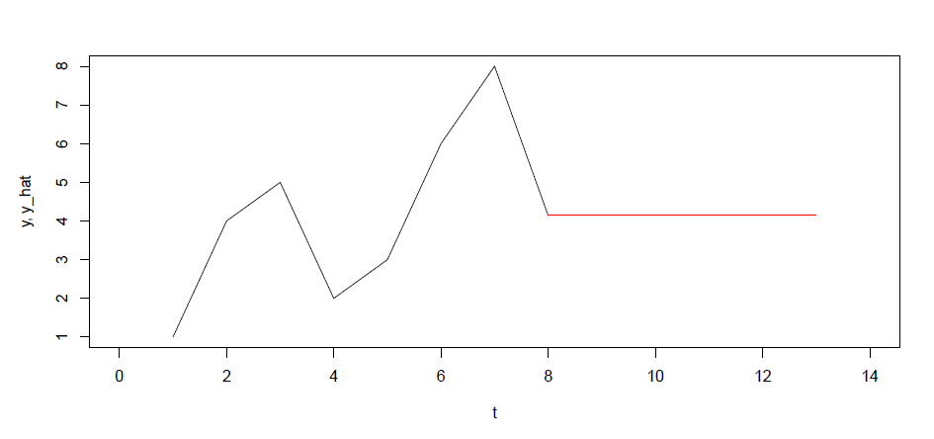
What is Exponential Smoothing
Forecasts produced using exponential smoothing methods are weighted averages of past observations, with the weights decaying exponentially as the observations get older. In other words, the more recent the observation the higher the associated weight.
Naïve : 100% weight on the most recent observation
MA : equal weight on k values

Slide 3
Exponential Smoothing Methods
Simple Exponential weighted average — Recent observations get higher weight, older observations less weight. Suitable for data with no clear trend or seasonal pattern.
Holt’s Linear Trend method - Extended simple exponential smoothing to deal with data with a trend.
Holt-Winters Seasonal method — Extended Holt’s method to capture seasonality
State Space—ETS models allow for prediction intervals along with point forecasts

Slide 4
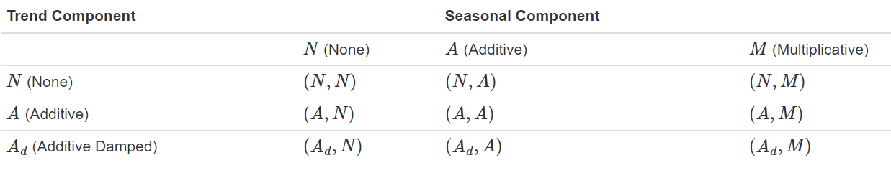
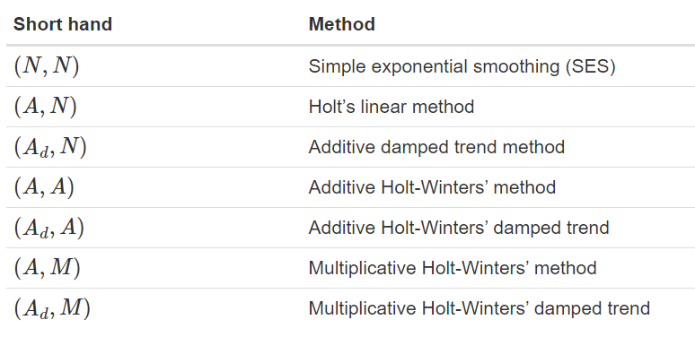
Which method to use?

Slide 5
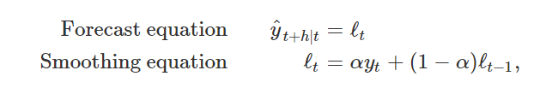
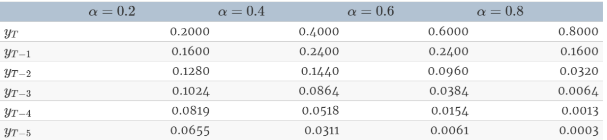
Simple Exponential Smoothing (SES)
No Trend No seasonality

Slide 6
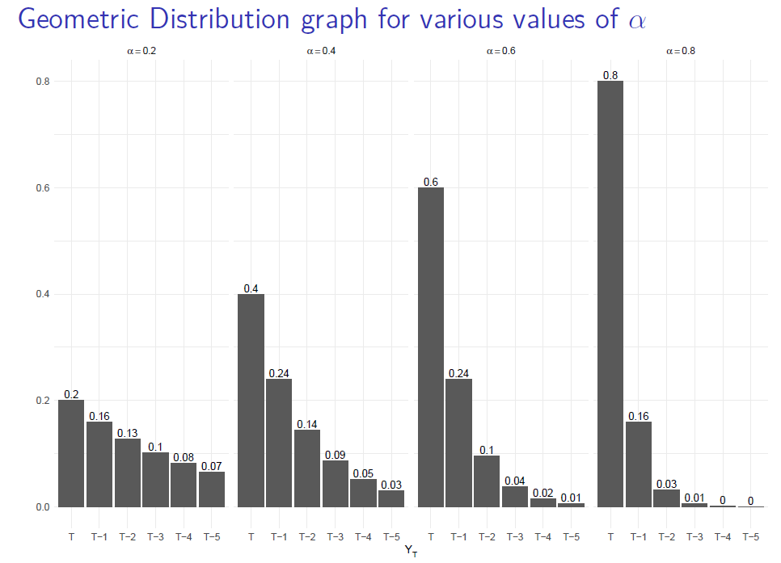
Simple Exponential Smoothing continued

Slide 7
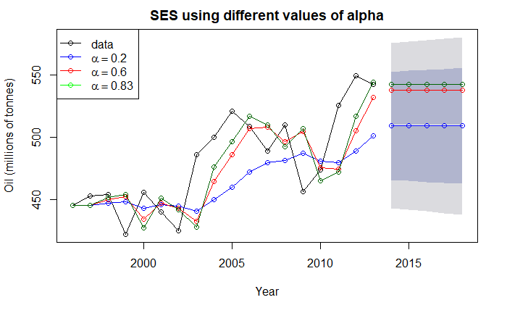
Simple Exponential Smoothing continued
If no value if given, Alpha is
obtained by minimizing SSE over periods t=1,2,…,18 subject to the restriction that 0≤α≤1

Slide 8
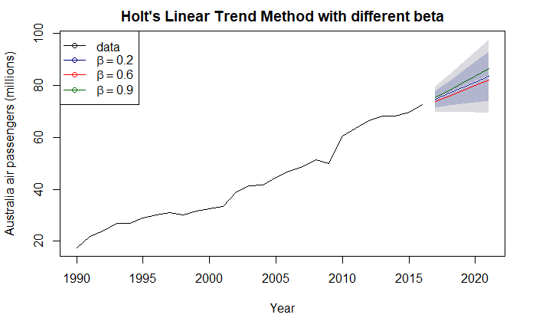
Holt’s Linear Trend Method
The forecasts generated by Holt’s linear method display a constant trend indefinitely into the future, tend to over-forecast for longer horizon
Does not take care of seasonality!

Slide 9
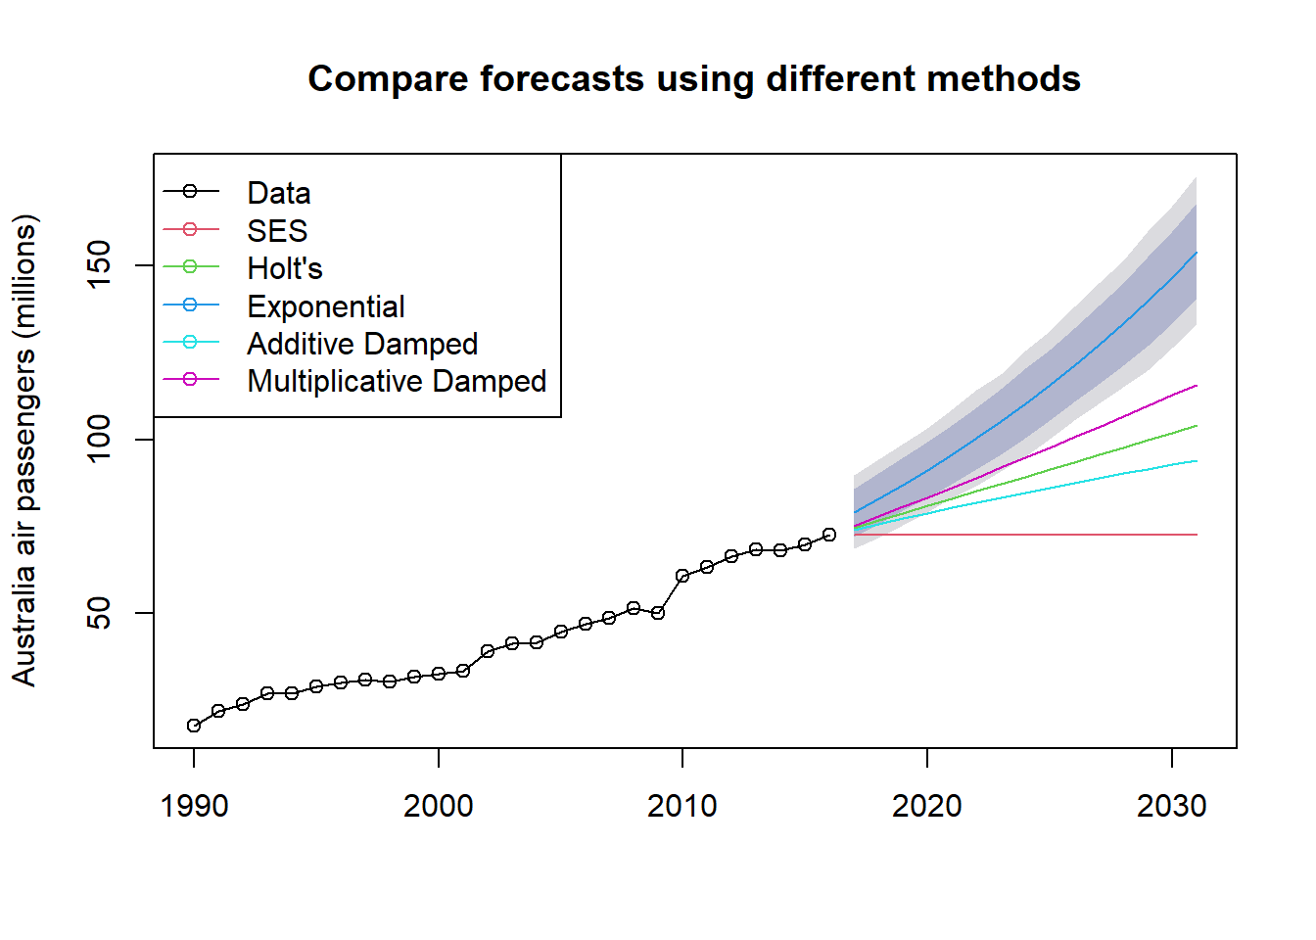
Other variations of trend method
Dampened method:
Also includes a damping parameter 0<ϕ<1
For values between 0 and 1, ϕ dampens the trend so that it approaches a constant some time in the future.
Exponential : level and slope multiplied, the forecasts project a constant growth rate rather than a constant slope, tend to over-forecast

Slide 10
Holt-Winters Exponential Smoothing
Third Type of Exponential Smoothing
Extends the Holt Model
Accounts for Trend or Seasonality or Both
Comprised of the Forecast Equations and Three Smoothing Equations

Slide 11
Holt-Winters Exponential Smoothing Additive vs. Multiplicative
Additive Seasonality | Multiplicative Seasonality
Uses addition to add seasonal component | Uses multiplication to multiply the seasonal component
Seasonal component is expressed in absolute terms | Seasonal component is expressed in relative terms
For different seasons, we get forecasts that are different by a fixed amount | For different seasons, we get forecasts that are different by a percentage
Preferred when the seasonal variations are roughly constant through the series | Preferred when the seasonal variations are changing proportional to the level of the series.

Slide 12
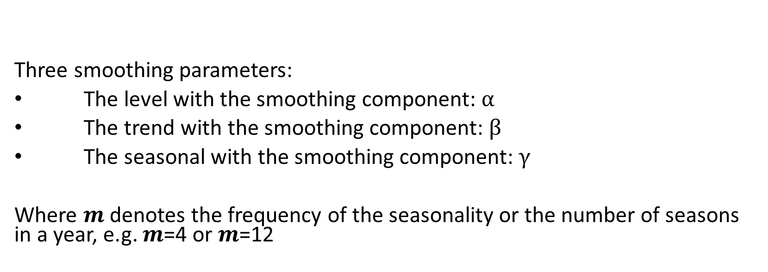
Holt-Winters Exponential Smoothing Additive Method
Three smoothing parameters:
The level with the smoothing component: $α$
The trend with the smoothing component: $β$
The seasonal with the smoothing component: $γ$
Where $m$denotes the frequency of the seasonality or the number of seasons in a year, e.g. $m$=4 or $m$=12

Slide 13
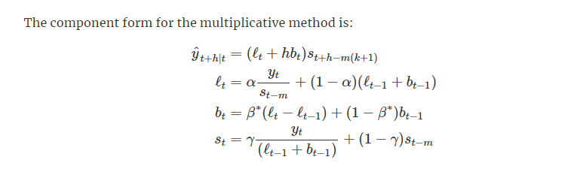
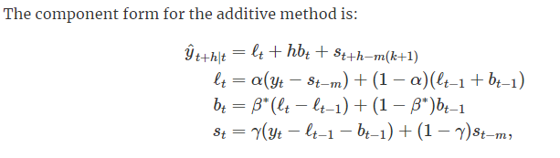
Holt-Winters Exponential Smoothing Additive Method

Slide 14
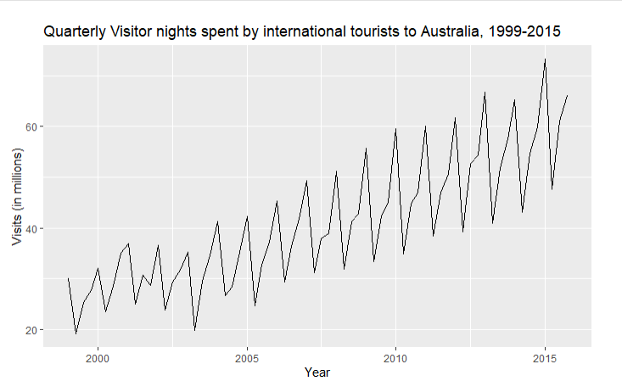
Example - Austourists Time Series

Slide 15
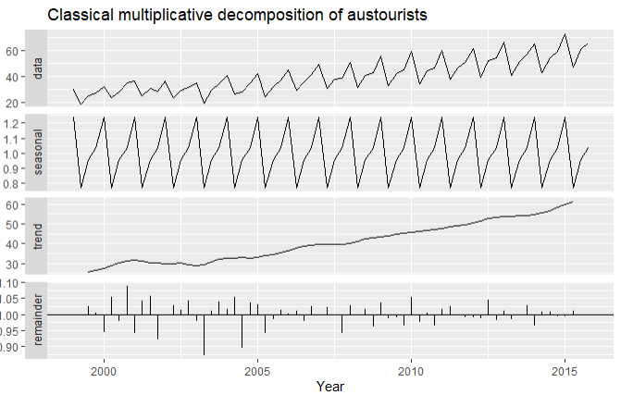
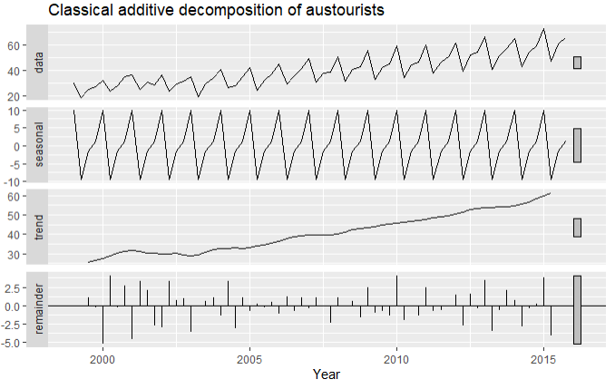
Example - Austourists Time Series Decomposition
Classical Multiplicative
Classical Additive

Slide 16
Example - Application of HW Function
Use the window function to save the time series to the “aust” variable
aust <- window(austourists, start=2005)
Both the Additive and Multiplicative options are applied
fit1 <- hw(aust, seasonal="additive")
fit2 <- hw(aust, seasonal="multiplicative")
Plot the series and the forecast

Slide 17
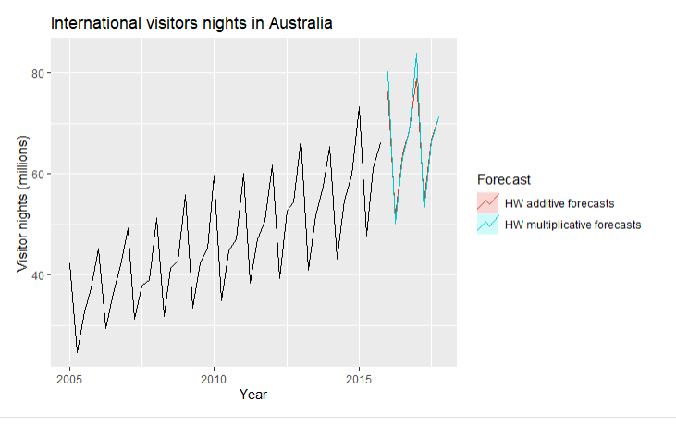
Plot

Slide 18
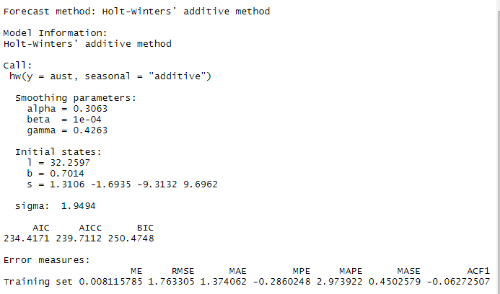
Smoothing Parameters and RMSE Additive

Slide 19
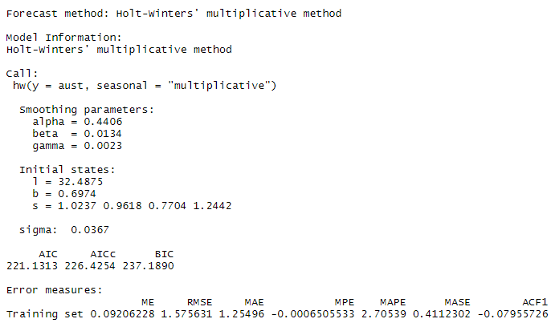
Smoothing Parameters and RMSE Multiplicative

Slide 20
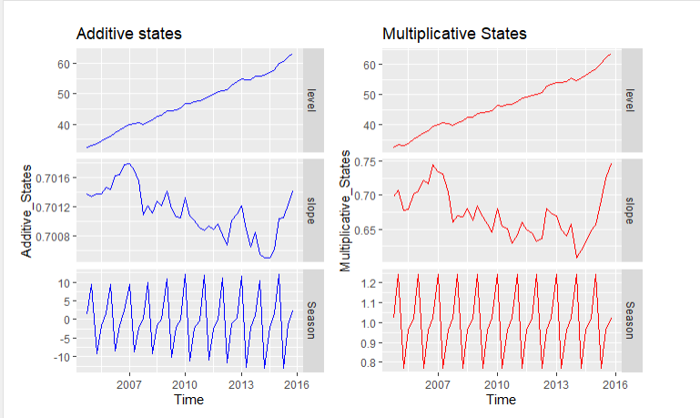
Additive vs. Multiplicative

Slide 21
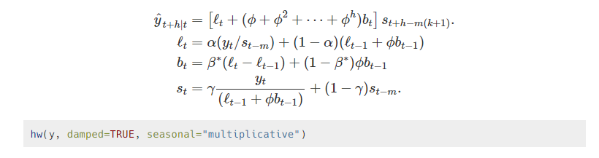
Holt-Winters’ Damed Method Holt-Winter's Damped Method
Provides accurate and robust forecasts for seasonal data

Slide 22
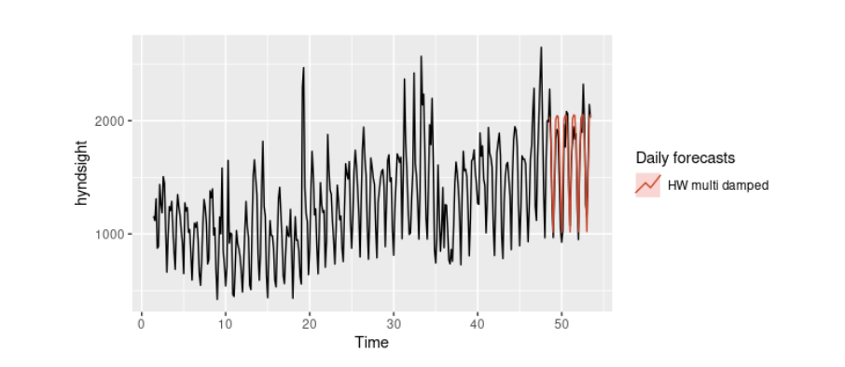
Plot

Slide 23
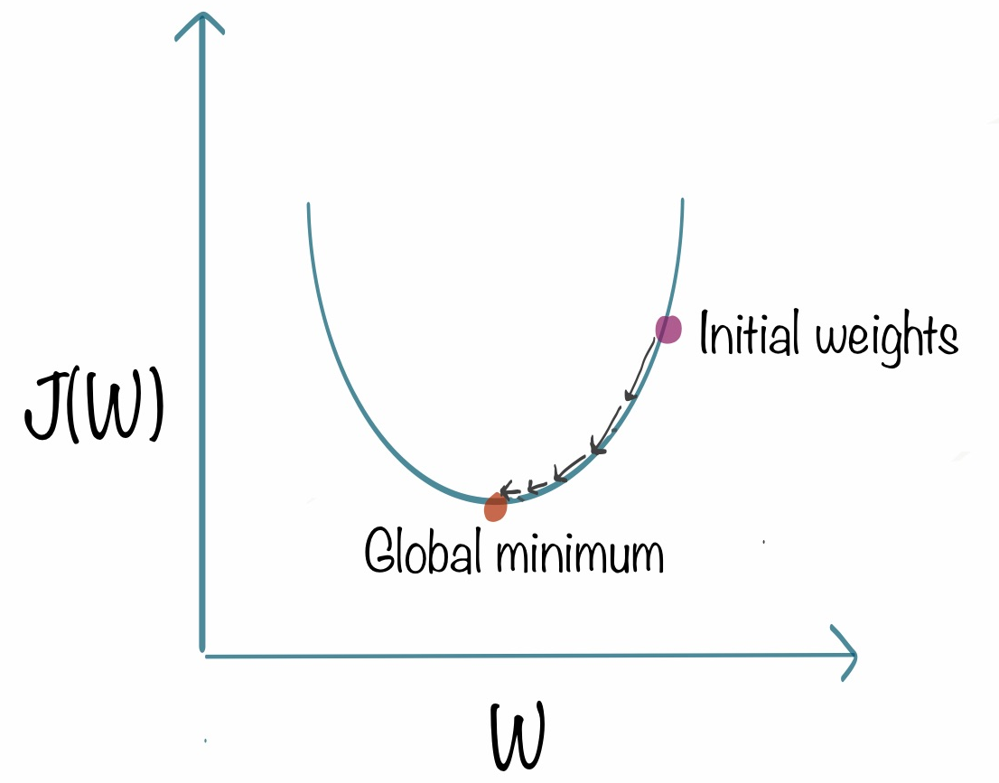

What does ETS Mean?
ETS (Error, Trend, Seasonality)
Utilize past observations to improve the forecasting.
Alpha is the smoothing parameter
Recent observation has more weight than the past obs.
(weight is decreasing exponentially for past obs. - a.k.a gradient decent)
Source: https://www.kdnuggets.com/2018/06/intuitive-introduction-gradient-descent.html

Slide 24
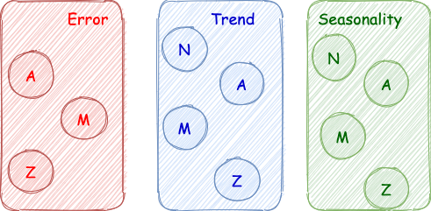
How do I choose the right Model?
Selection process :
A -> Additive
M -> Multiplicative
Z -> Unkown
N -> None
Model = 'AAN'
Holt’s model where the error and trend are additive with no seasonality exists

Slide 25
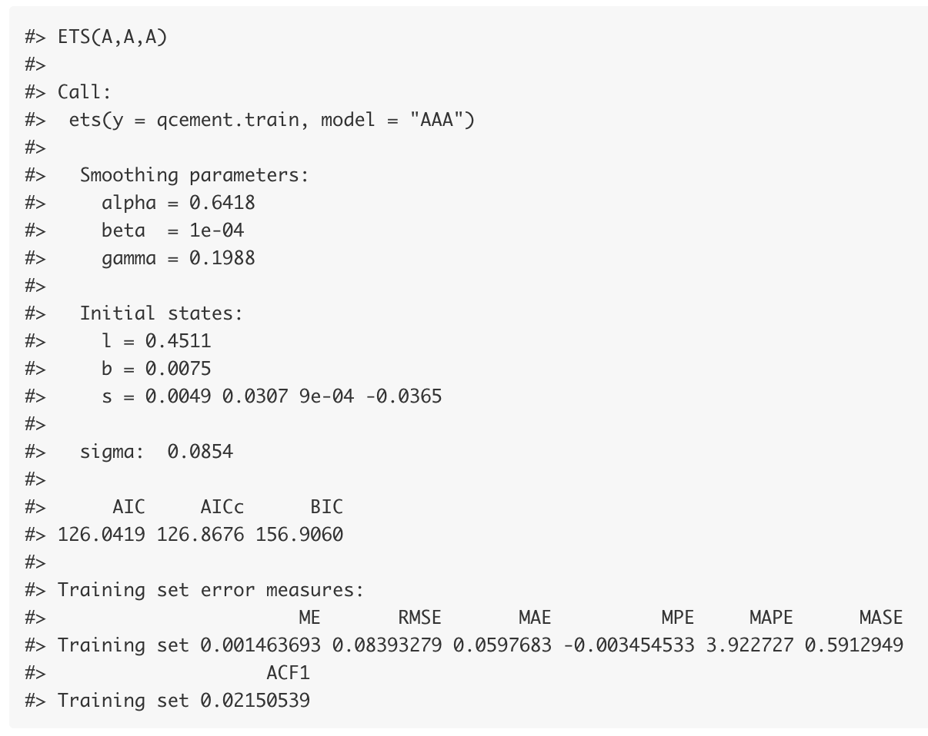
How do I buid the model?
Identify the model's parameters
Split the data (Train, valid)
Apply the ets()
The default estimation method is
maximum likelihood rather than minimum sum of squares.

Slide 26
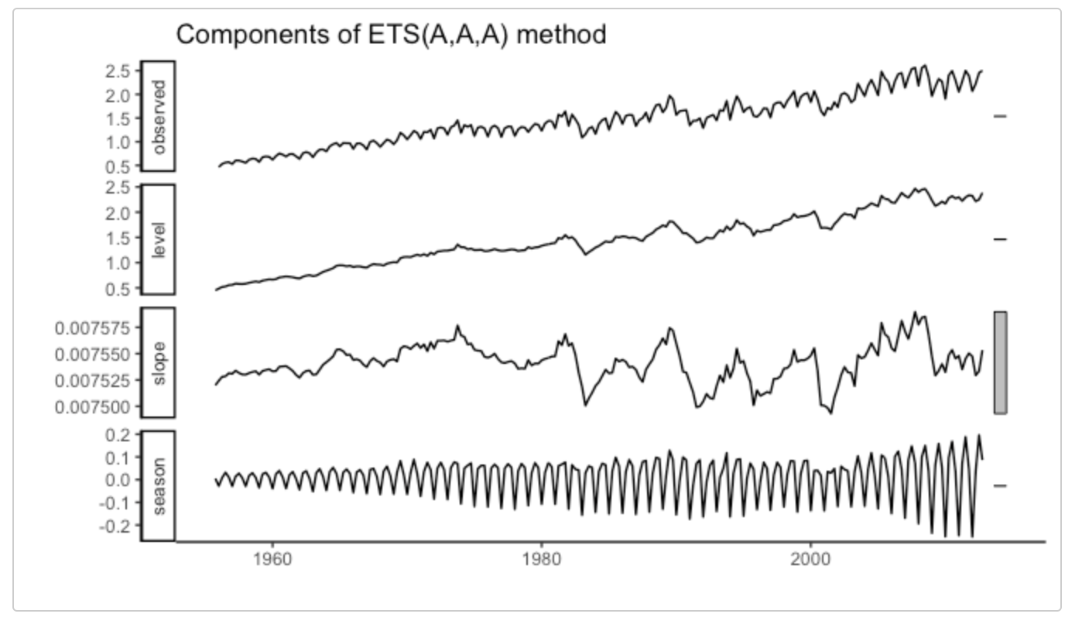
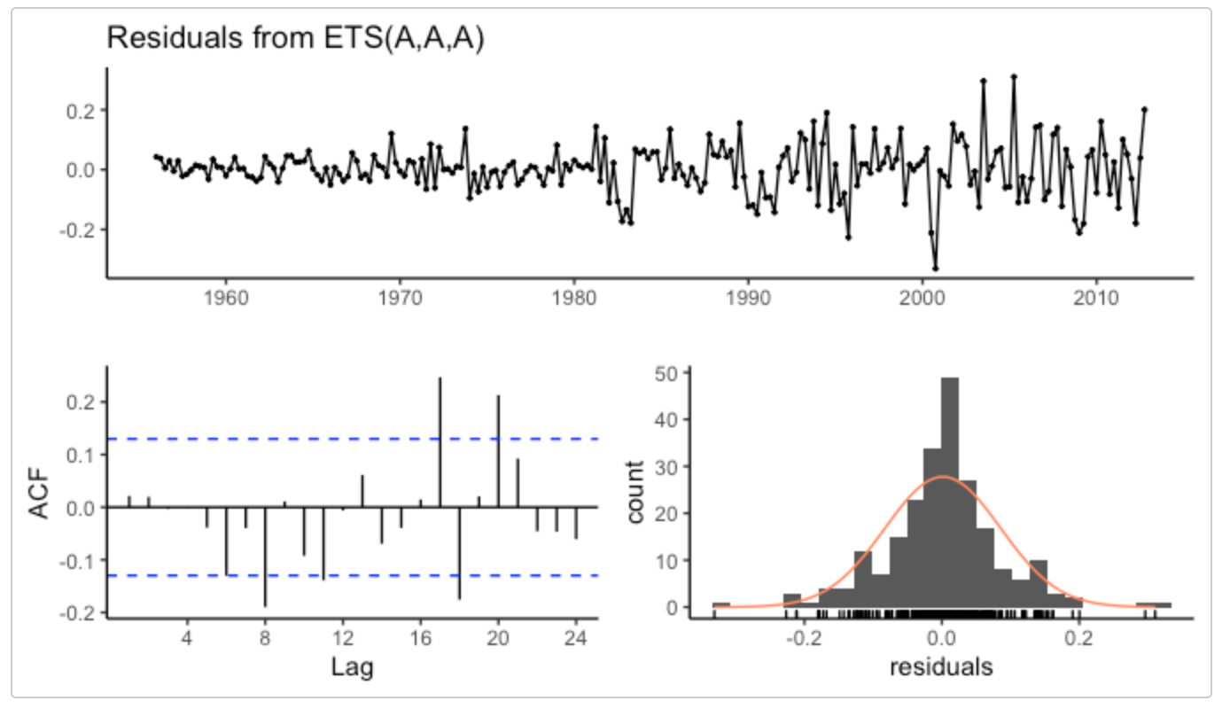
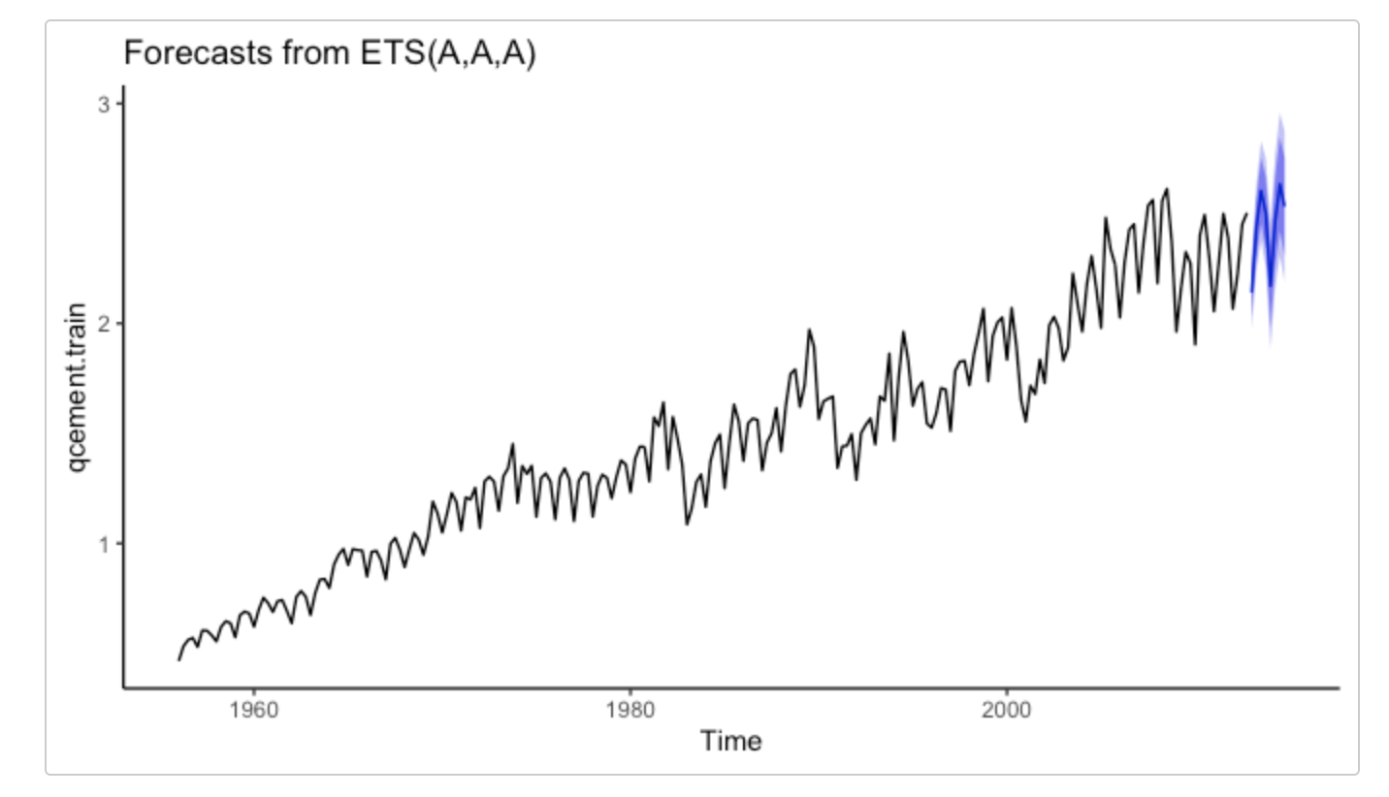

Why the AAA is not appropriate?

Slide 27
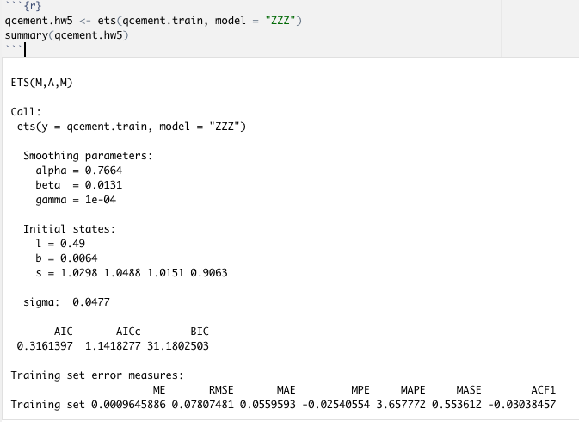
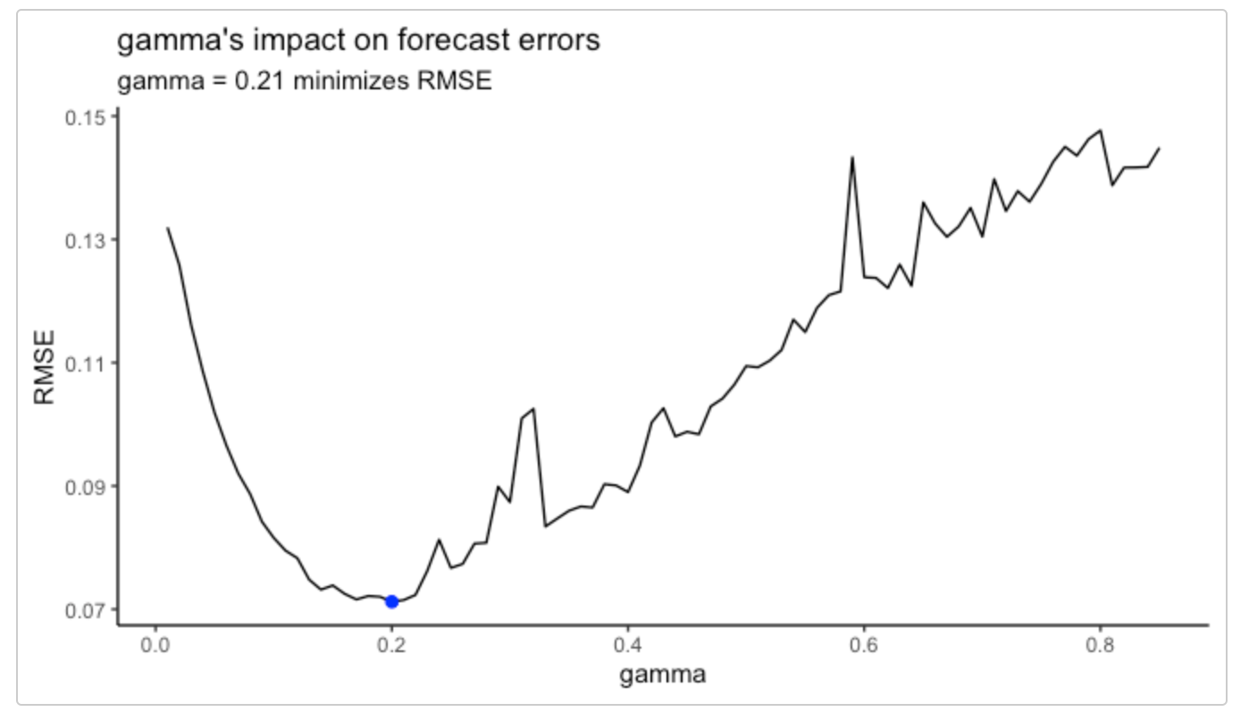


How to select the optimal model
1. Let ets() to automatically select the model.
2. Select lambda with min RMSE programatically.
Then apply lambda inside the ets()
Finally, Get the accuracy on test data.

Slide 28

Questions

